Slide 1
cricRGUKT
a cricket scoreboard system

Slide 2
cricRGUKT
Project by: Guided by:
Team 5 CSE 3E Y.Kumar sekhar
S160447-V.Devi Srinivas Asst. professor
S160082-K.Venkat CSE Dept.
S160281-Rehmath Banu RGUKT,Srikakulam.

Slide 3
CONTENTS:
Abstract
Introduction
Motivation
existing and proposed
Implementation Details
Samples and result
conclusion
timeline

Slide 4
ABSTRACT
The project entitled "cricRGUKT" is a cricket scoreboard system that is utilized by the user with an update of the cricket score even when the user is not watching the match. This project aims to make a cricket scoreboard that will update the scores of a match.The website is mainly for RGUKT students and can be used during Department Premier Leagues(DPL) and other individual matches.The live updates of the matches being played can be updated on this website and can be viewed by anyone.

Slide 5
INTRODUCTION:
Cricket being a special part of the lives of many people, there will be many takers for such a system, and the ability to follow the match without seeing the video will make it interesting for many.
Each and every match details such as the description about the team and team members will be stored in the repository system in the form of a database.
As soon as someone checks the scoreboard, details of a particular player can be viewed with a single click on his name.

Slide 6
INTRODUCTION
A user who is unable to watch the event like someone who is busy with their work can easily check the scores on a regular basis and get updates on what is happening.
The system will keep posting updated scores and the team line-up during the match.
All details including the toss,matches already played,score,wickets, number of overs completed,number of 4s and 6s,details of a particular player,details of balls played in an over etc can be viewed.

Slide 7
INTRODUCTION
A person who creates the match is the admin.An accont must be there for the same.After match creation, the admin must add the players who are going to play the match.After all the necessary details are entered,only the admin can update the scores and make other changes.
The scores and other updates of the match are displayed to the user once the user opens the website.There is no need of refreshing the website every time to view updated scores, they and other fields will be updated automatically

Slide 8
Motivation
In existing System users cannot create matches.
So, there is no way to host our matches in Cricbuzz
By our Project any body can create matches or update scores by admin id.
This option increases more users for us.
And anybody from anywhere can use our site and can create matches.

Slide 9
Existing and proposed
In the existing project, one can watch live scores and can able to see macthes schedules,livescores,player stats,series stats,point table etc
But cannot create live or scheduled matches themselves.
Proposed System
So by our project we are giving the option to users to create their matches and can update scores by themselves.
And in our project anyvody can create matches and can able to visit the player profiles thre stats,playing 11 of both teams,toss,livescores,bench players etc.

Slide 10
Implementation Details
FRONT END: HTML, CSS, java Script, bootstrap
BACK END: Php , JQuery
DATABASE: MySQL
Server : Xampp Localhost Server

Slide 11
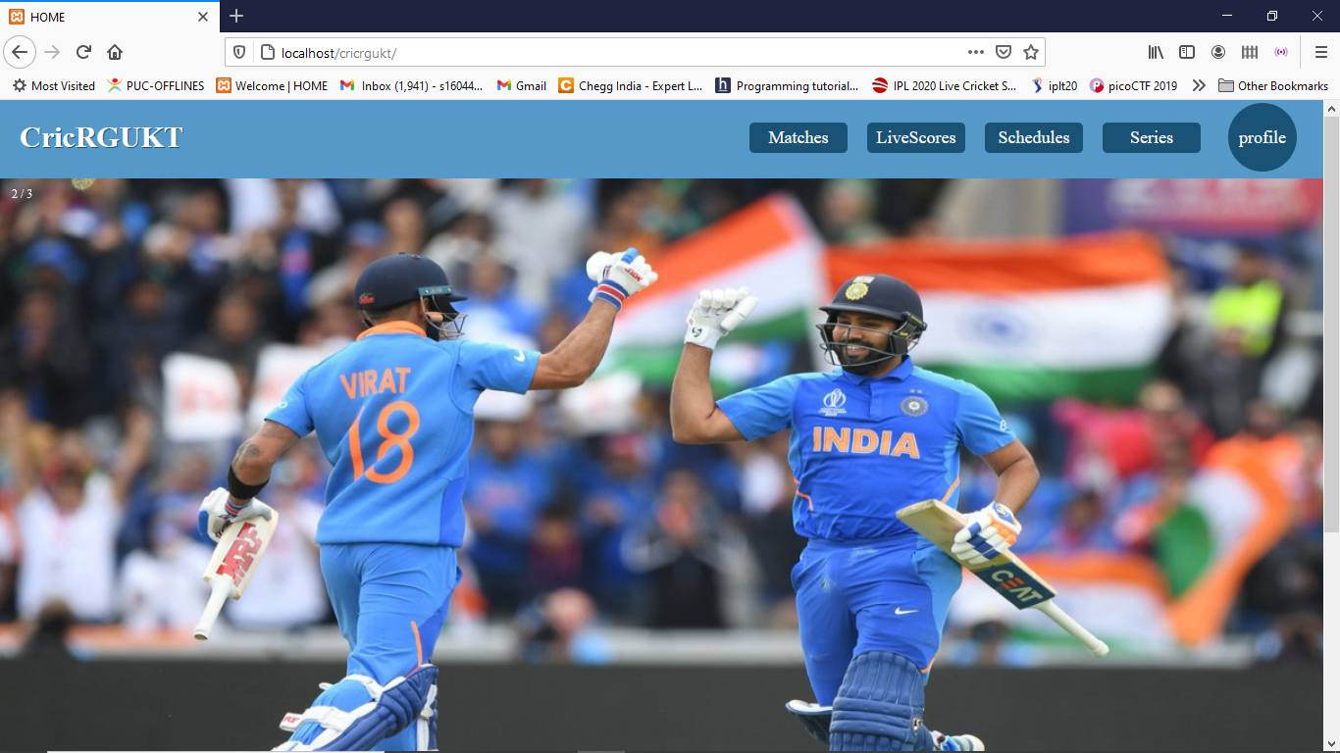
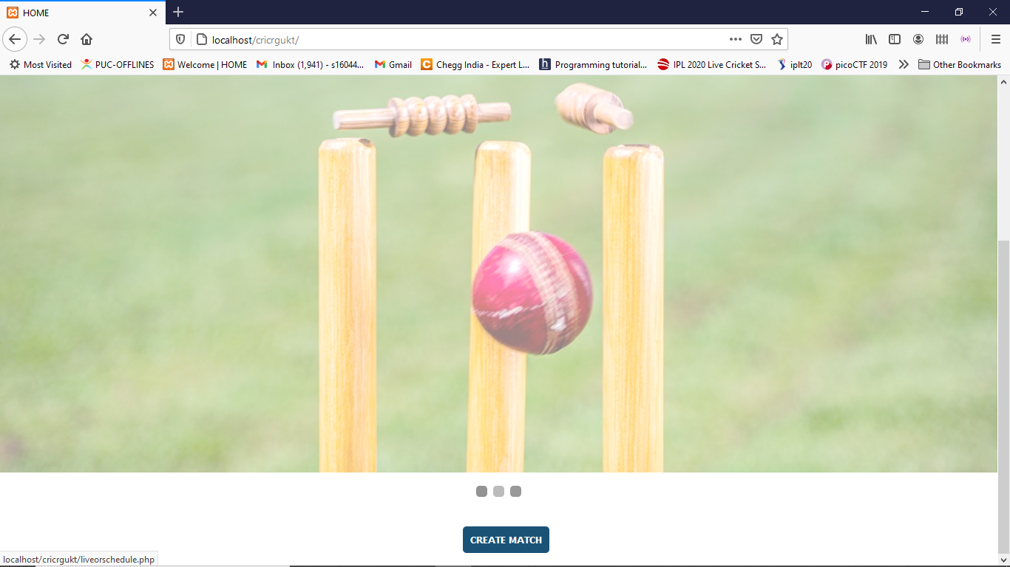
Samples And Results
Admin side

Slide 12
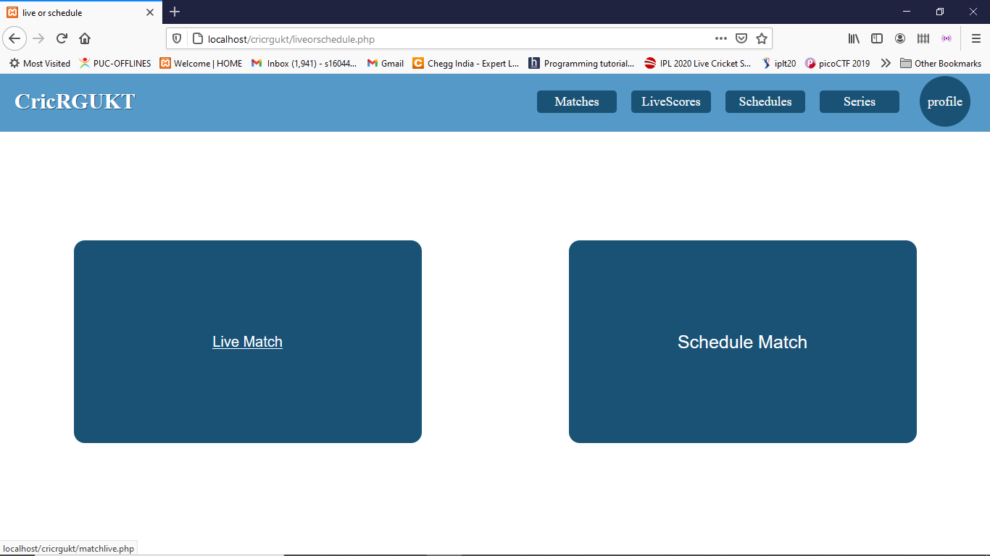
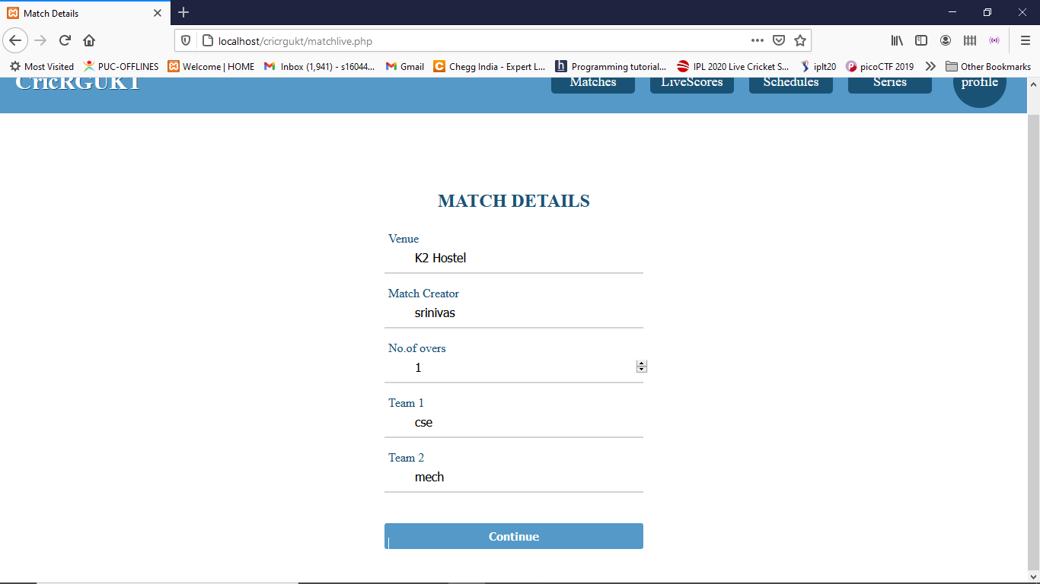

Slide 13
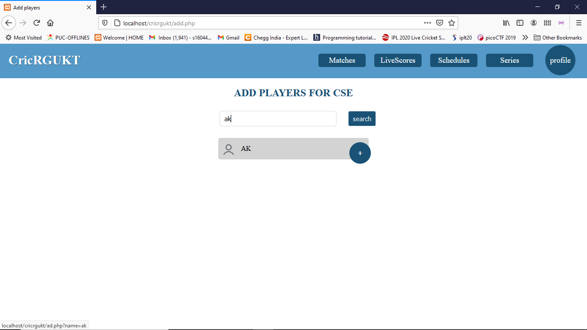
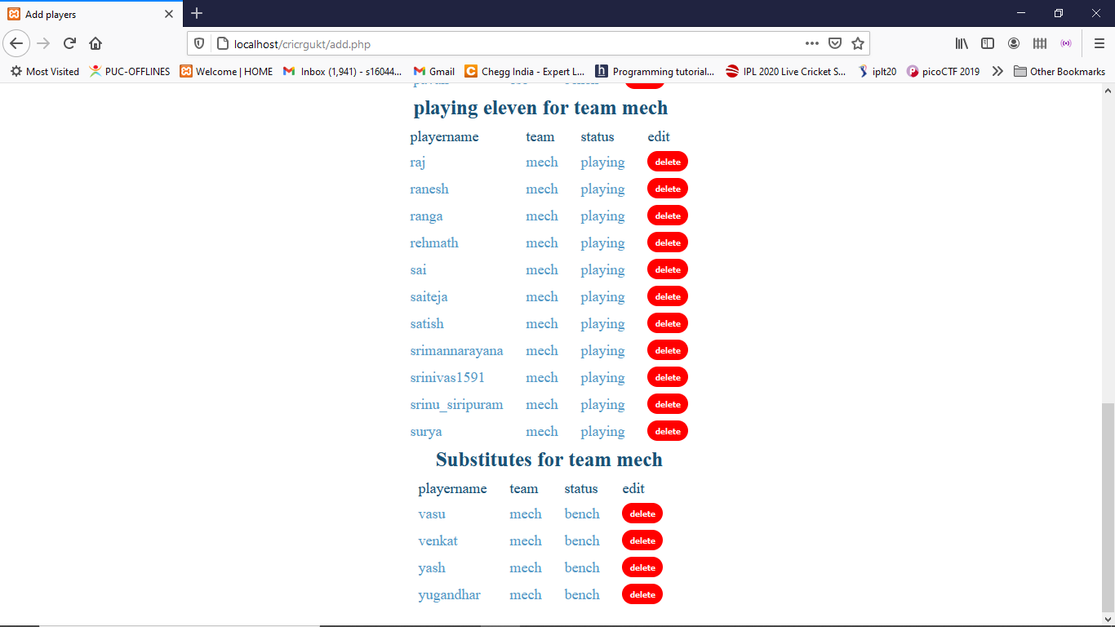

Slide 14
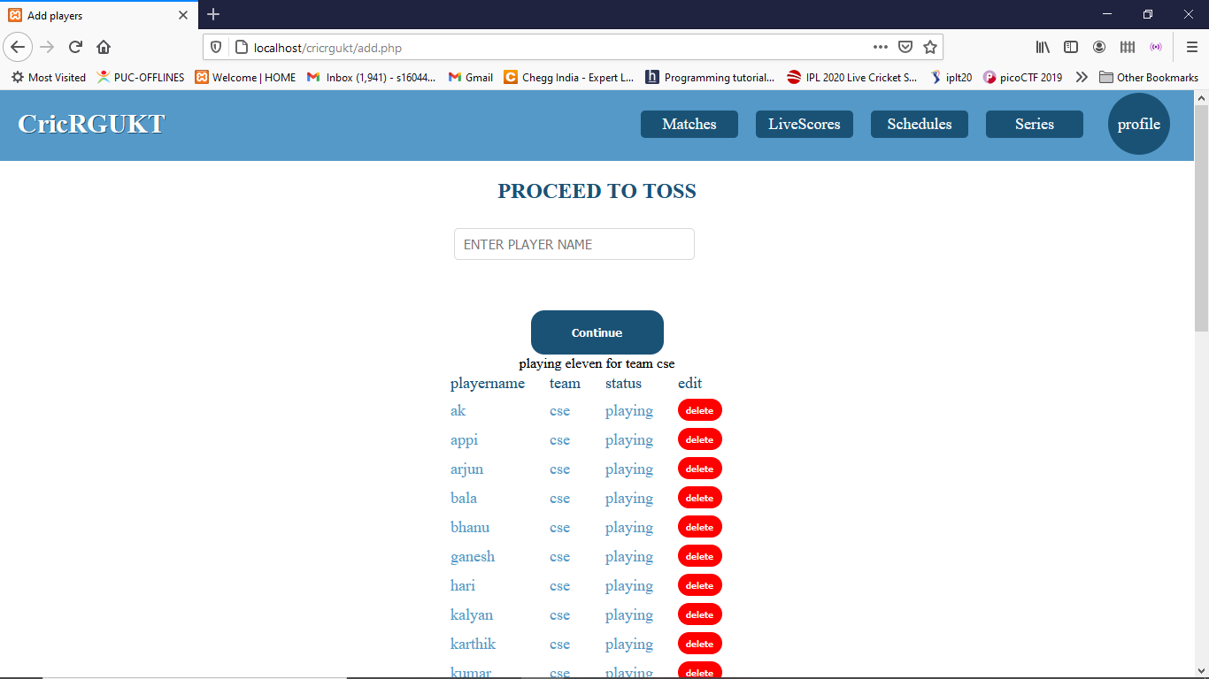
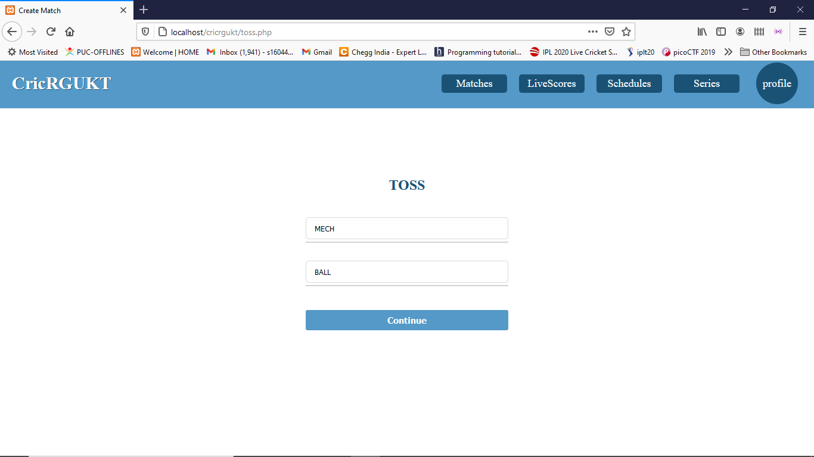

Slide 15
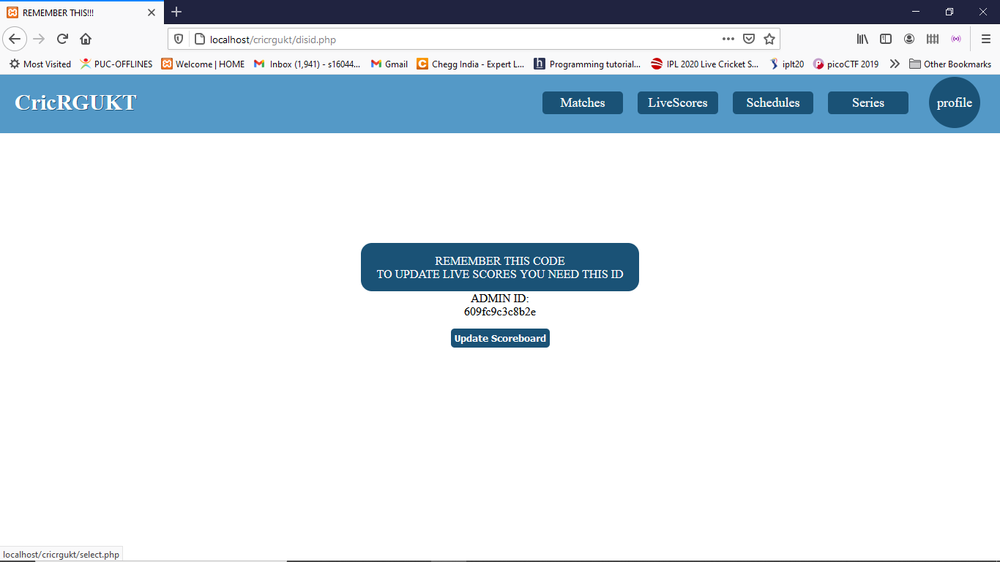

Slide 16
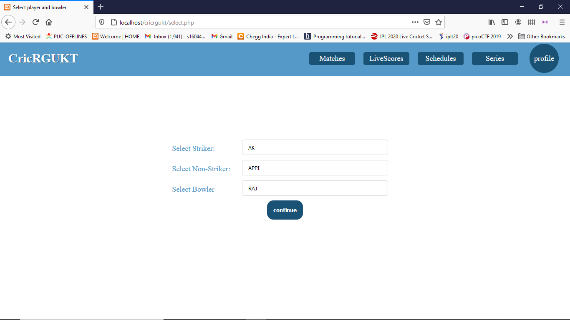
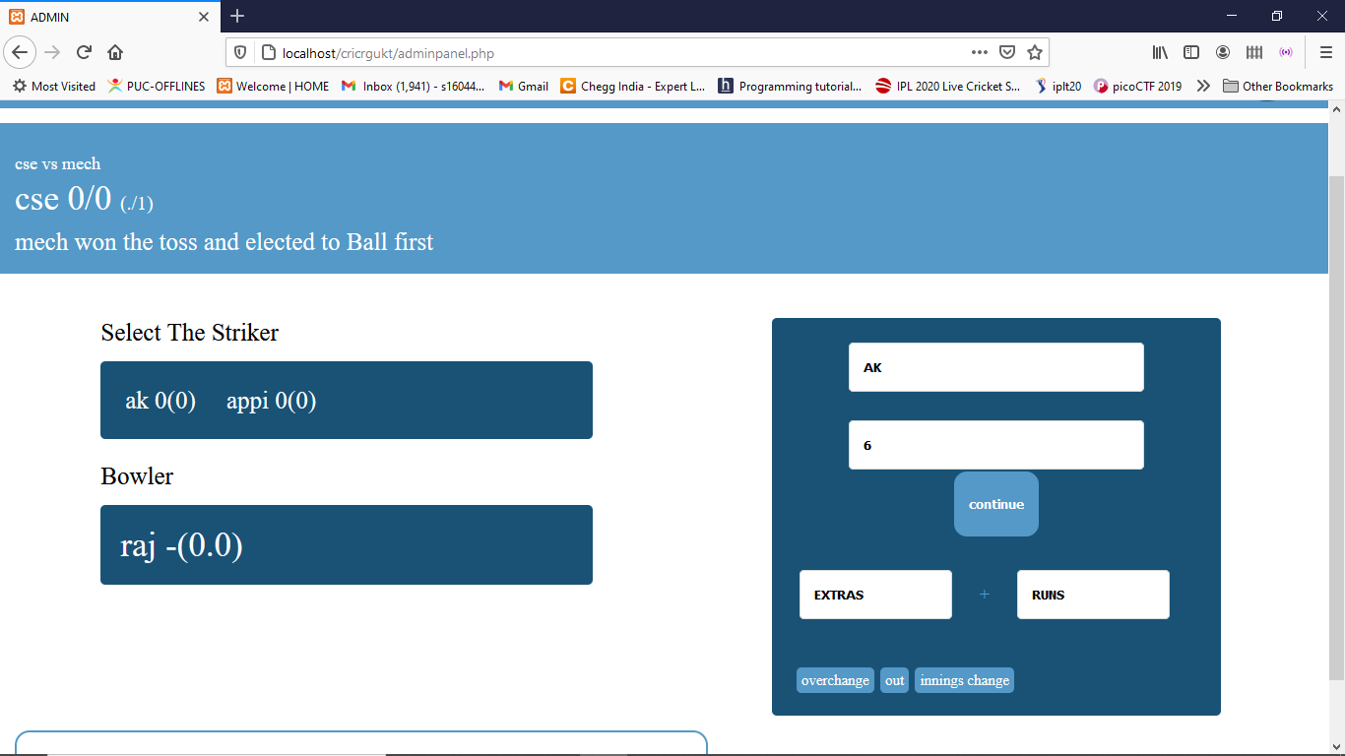

Slide 17
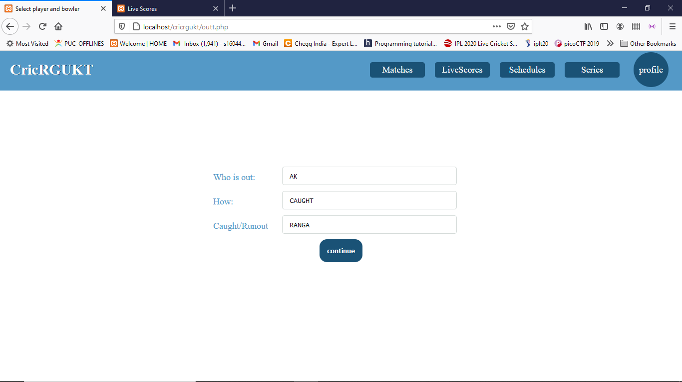
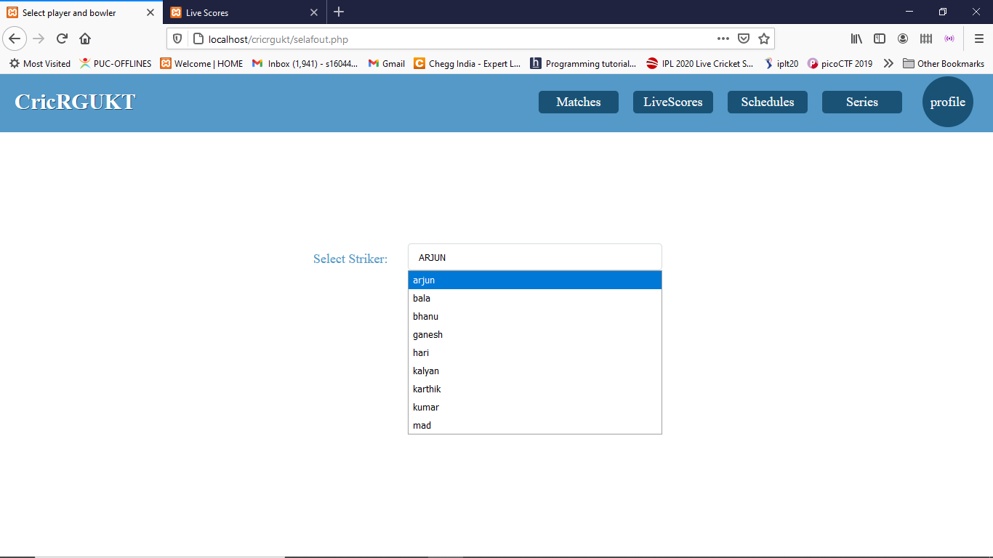

Slide 18
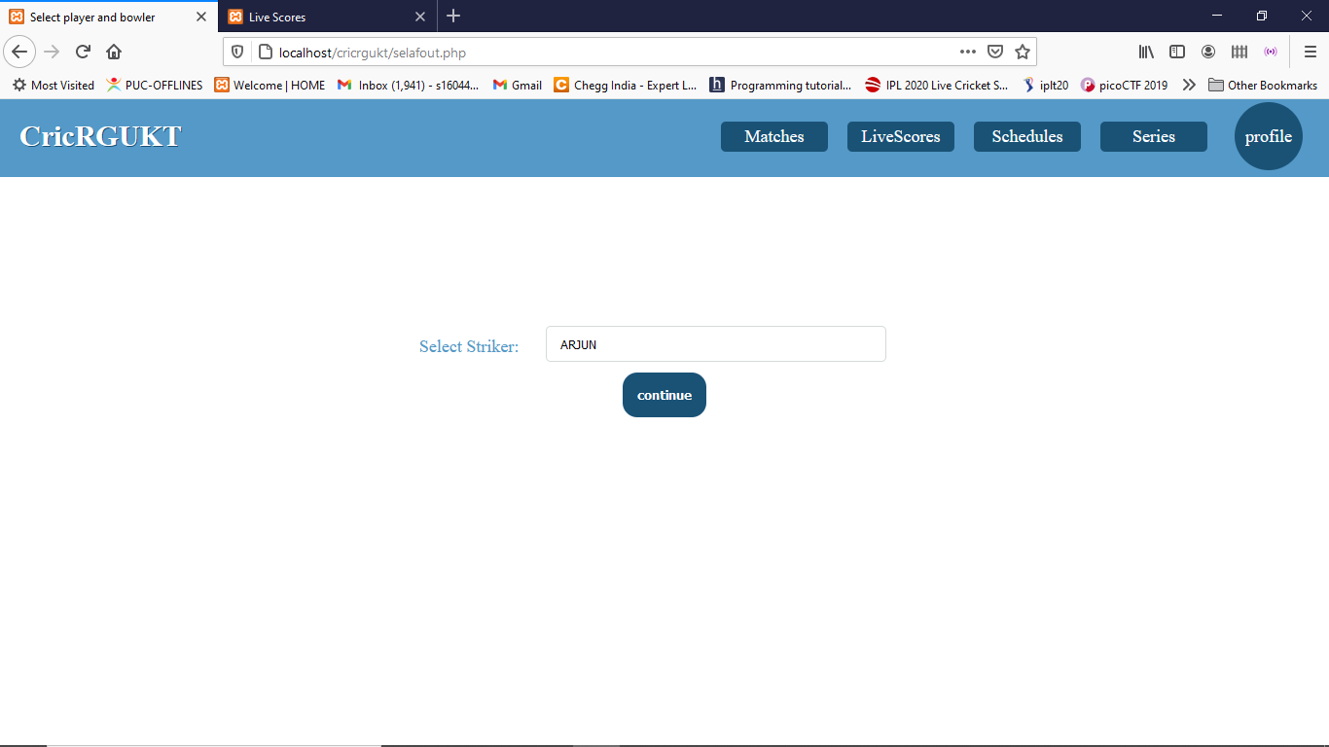

Slide 19
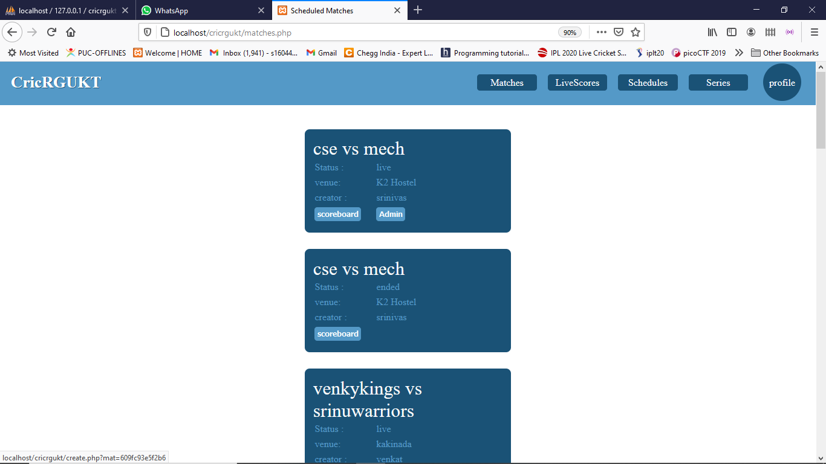
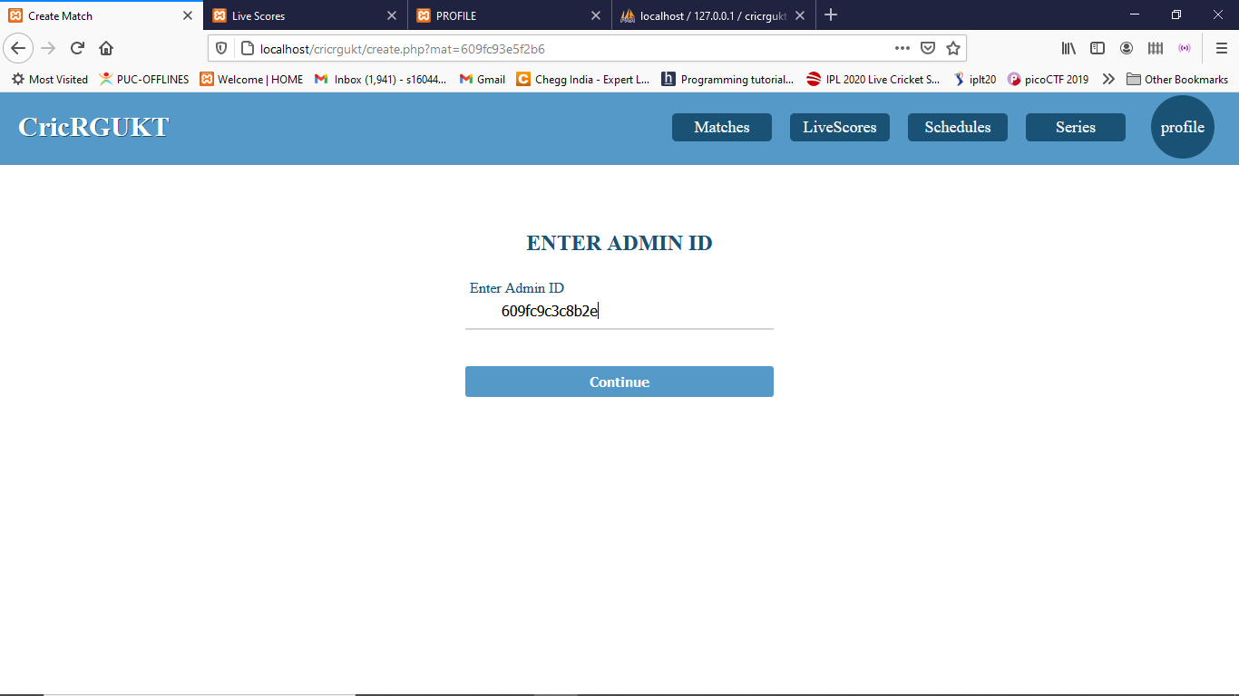

Slide 20
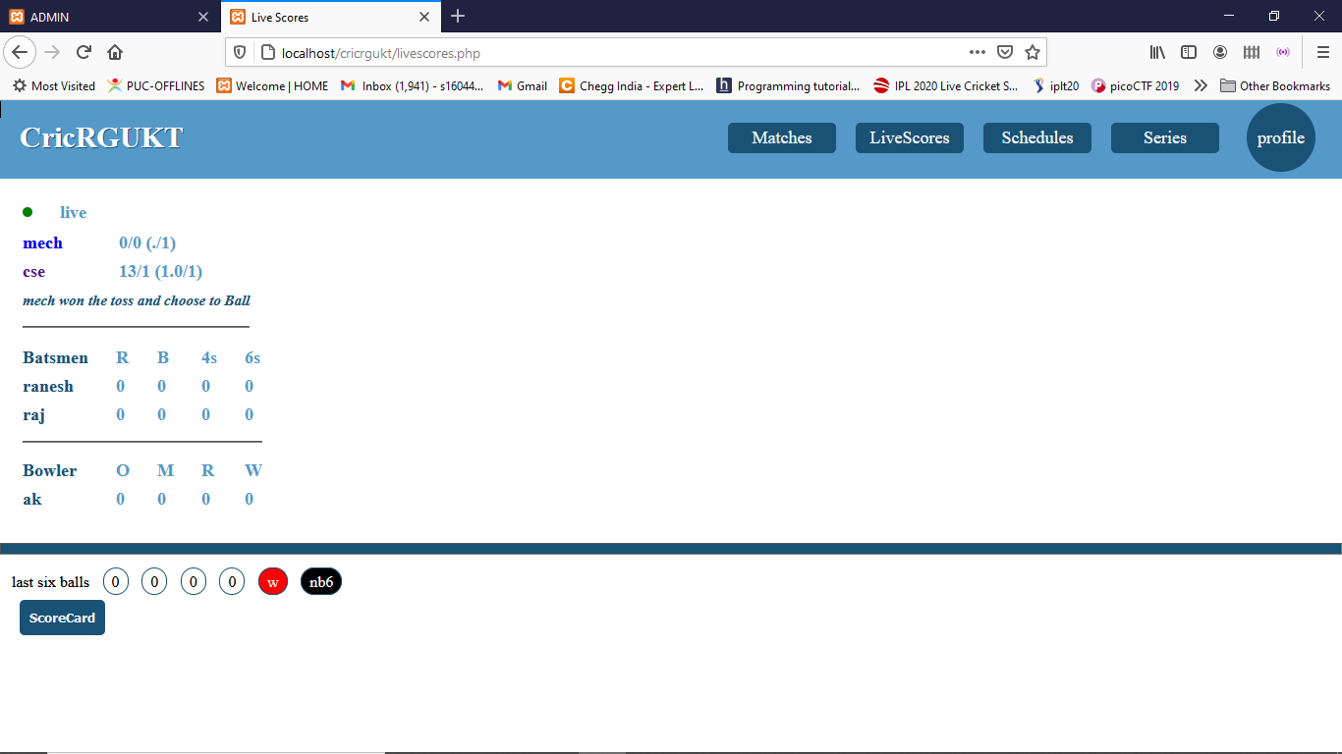
User Side

Slide 21
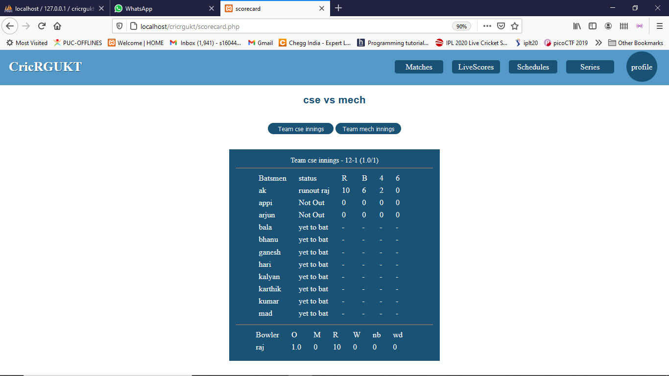

Slide 22
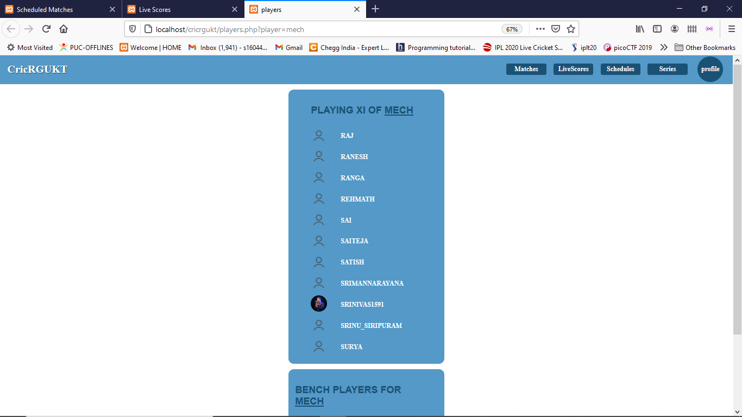

Slide 23
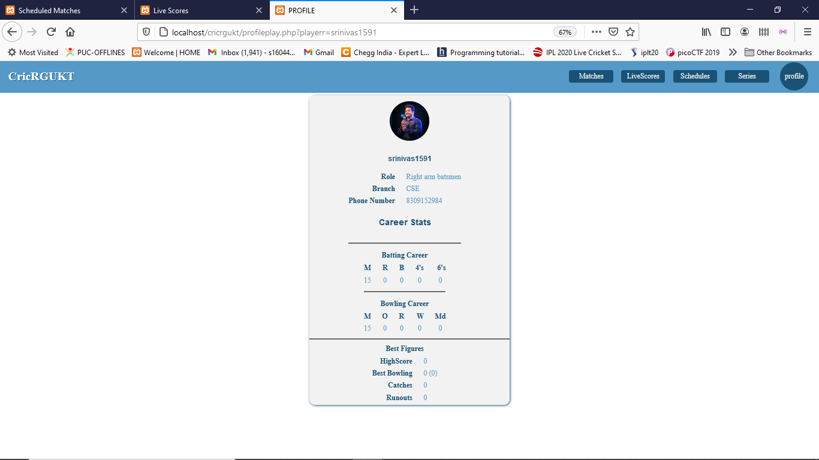

Slide 24
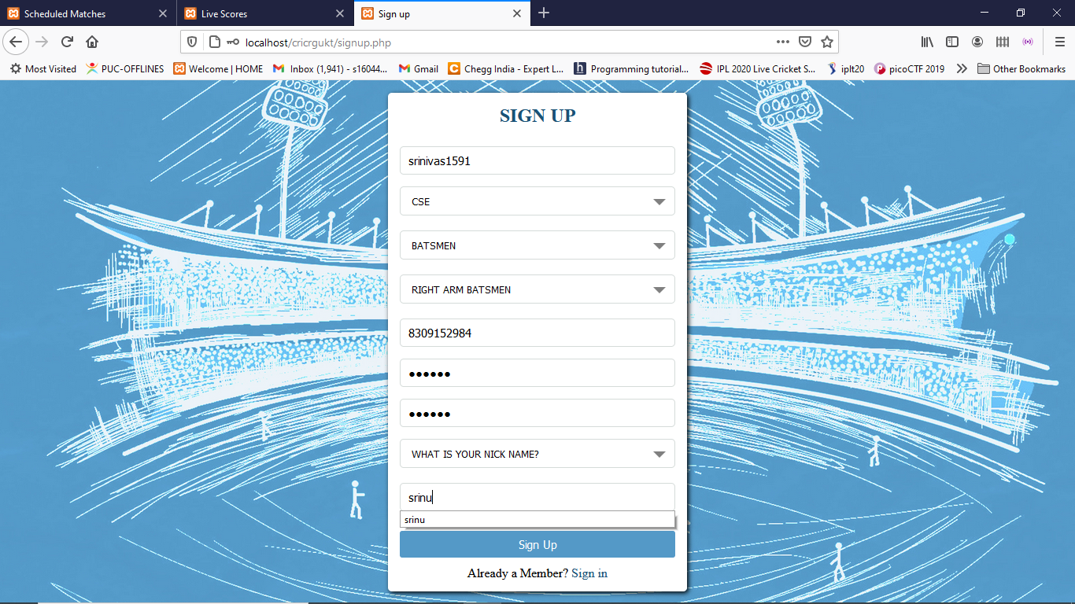
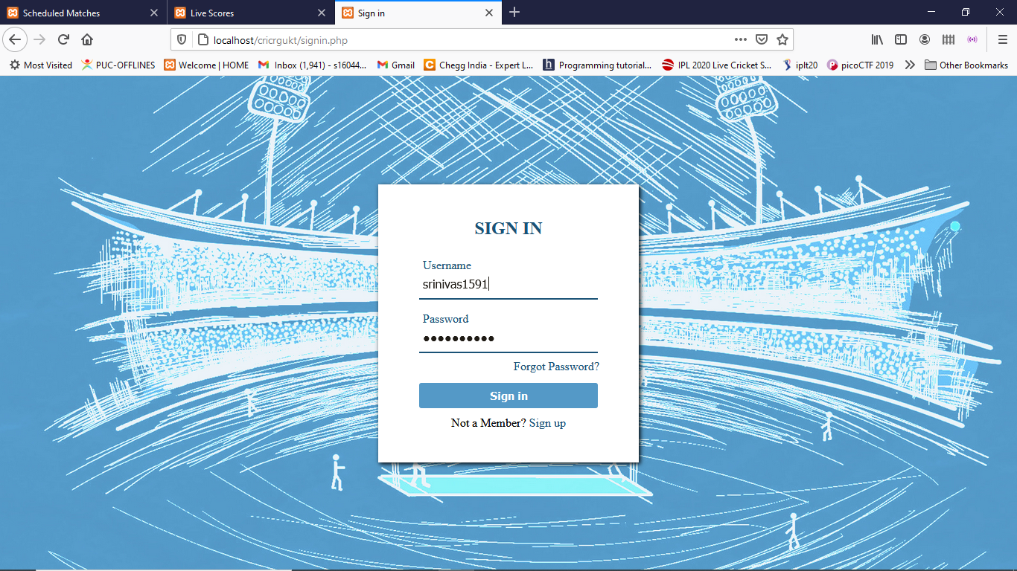

Slide 25
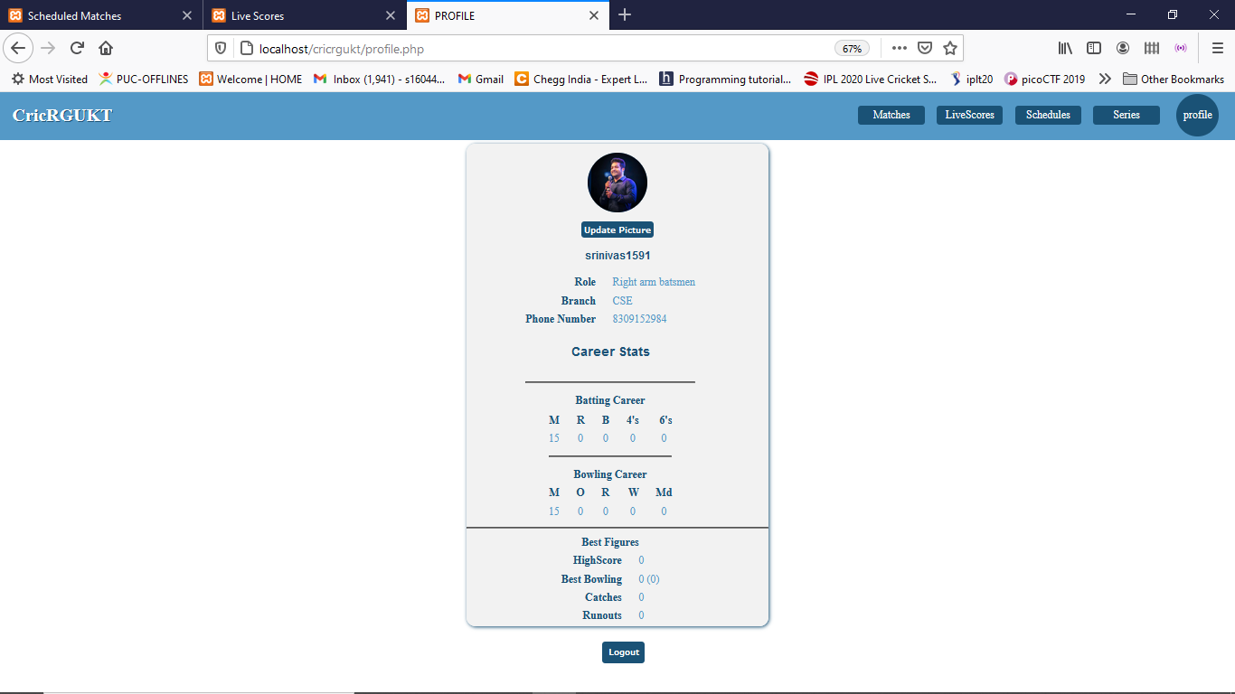

Slide 26
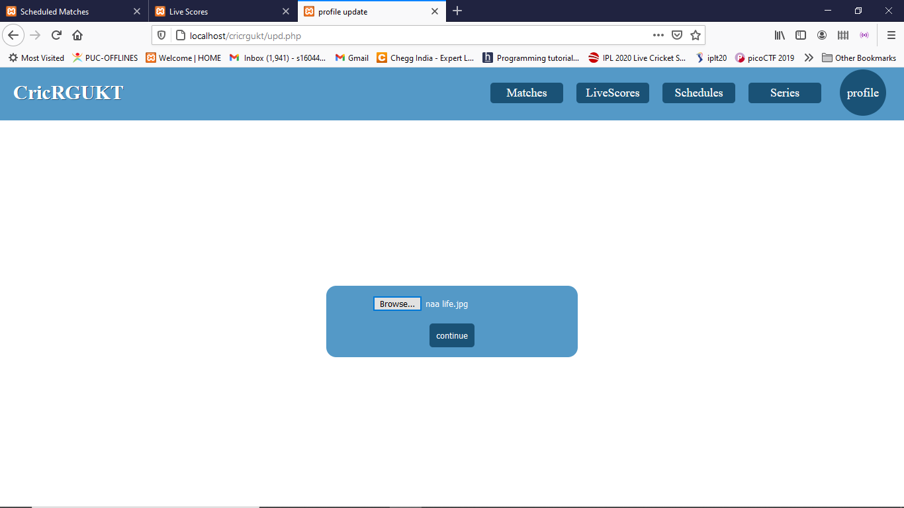

Slide 27
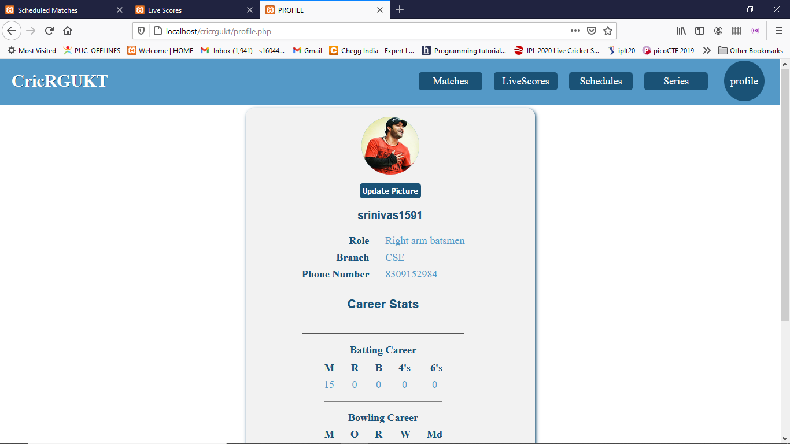

Slide 28
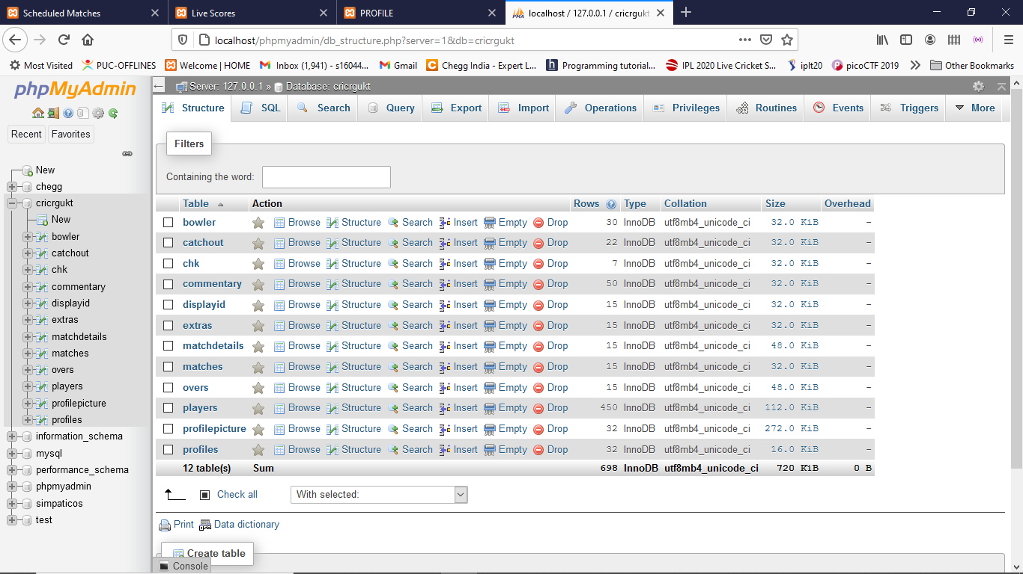
Database

Slide 29
Conclusion
CricRGUKT has many advantages for the endusers.
Unique facility like anybody can create and schedule matches.
and can update scores is the one of its kind feature.
It enables us to gain more users for our project.
End user can abe to see livescores teams,playing 11 and players stat.
The proposed system was designed and implemented using the HTML,CSS,JAVASCRIPT,AJAX,JQUERY,PHP.

Slide 30
Timeline
Rehmath Banu
Role : Design, Documentation + Frontend
Duration : 19 Hours
Karanam Venkat
Role : UI/UX + Frontend
Duration : 19 Hours
Vasamsetti Devi Srinivas
Role : FrontEnd + Backend
Duration : 19 Hours

Slide 31
References
Xampp server : https://www.apachefriends.org/download.html
Ajax : https://ajax.googleapis.com/ajax/libs/jquery/3.5.1/jquery.min.js

Slide 32
THANK YOU

